Slide 1
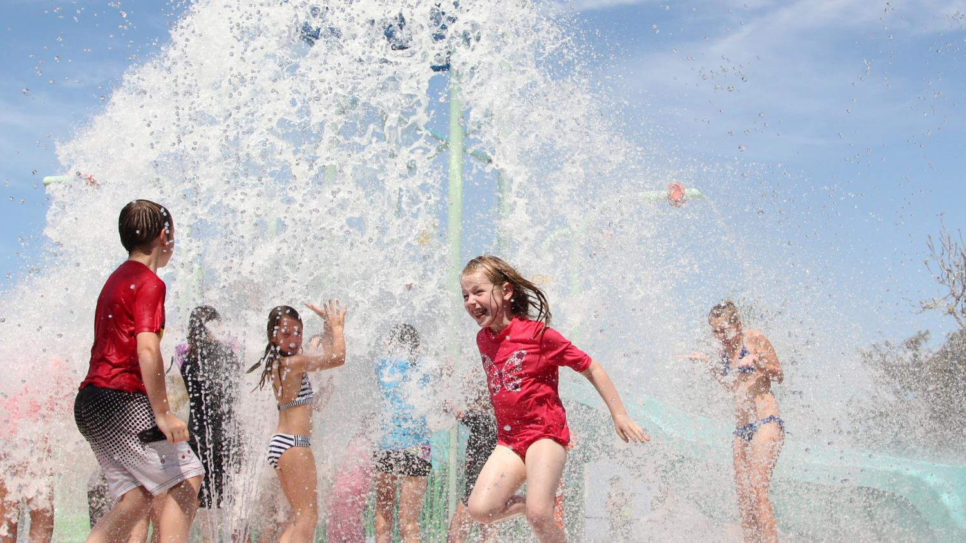
POOLPLAY™ & ELEVATION™
Notes:
Poolplay™ elements can enhance your pool or lazy river to provide an engaging and fun environment for all ages. Elevations™ add an extra dimension to pools to offer multi-level adventure in a stimulating environment.

Slide 2
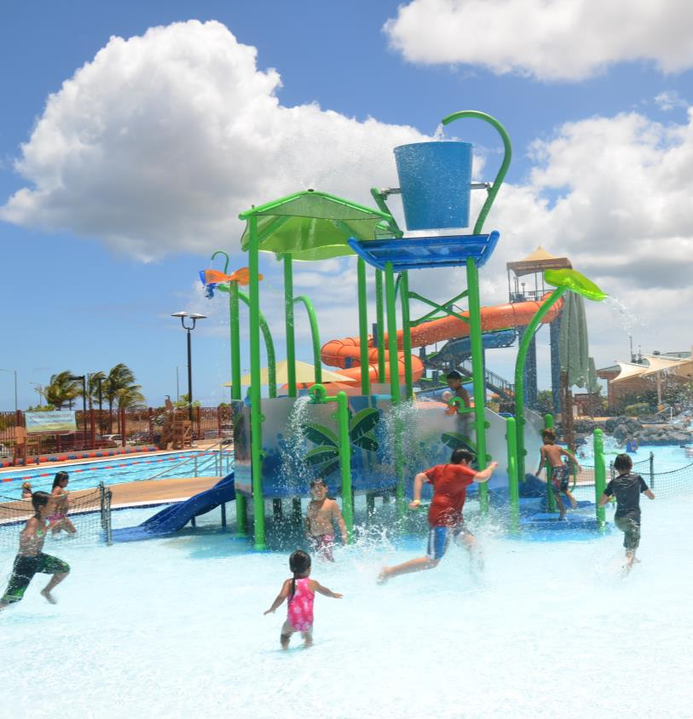

KEEP VISITORS ONSITE AND ENGAGED
OPTIONS FOR ALL POOL TYPES
Notes:
KEEP VISITORS ONSITE AND ENGAGED:
With multiple water effects, including jets, buckets, activators, cascades and sprays, the fun never ends.
OPTIONS FOR ALL POOL TYPES:
Big or small, indoors or out, Poolplay™ and Elevations™ are suitable for every facility.

Slide 3
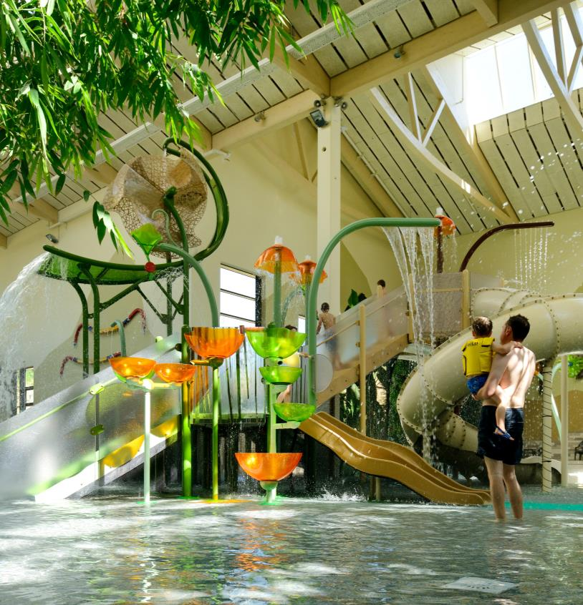

MODERN ARCHITECTURAL DESIGN
FLEXIBLE AND EXPANDABLE
RE-VAMP AND REFRESH
Notes:
MODERN ARCHITECTURAL DESIGN:
Styles and colors that blend with or complement the surrounding environment.
FLEXIBLE AND EXPANDABLE:
Modular Elevation™ configuration fits any size and location and can be added to over time.
RE-VAMP AND REFRESH:
Elevations™, water slides, cascades and lazy river features can revitalize your amenity.

Slide 4

THEMED ELEVATIONS™

Slide 5
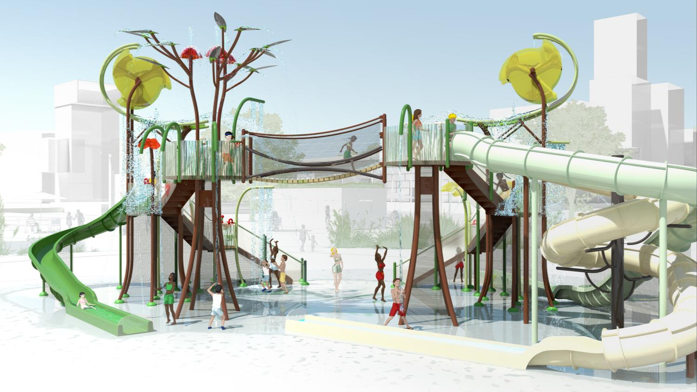
Elevations™ FOREST

Slide 6
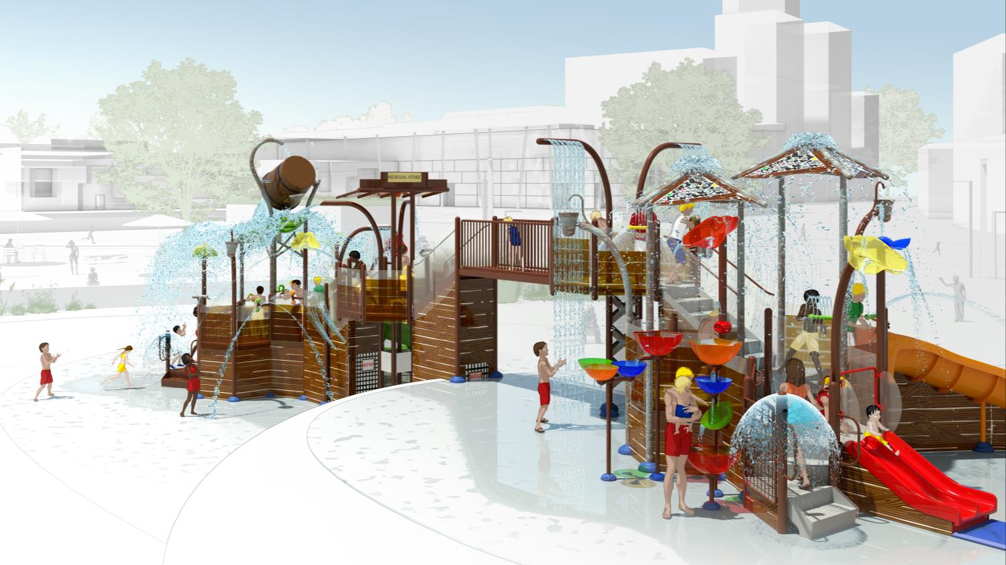
Elevations™ WESTERN

Slide 7
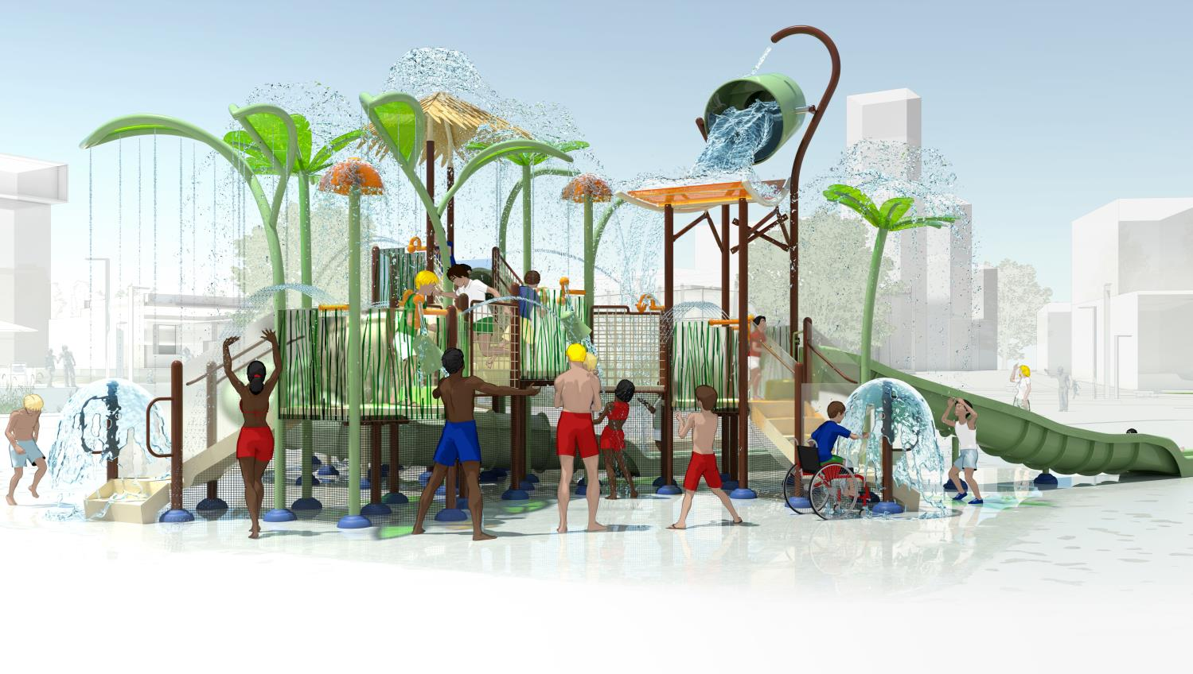
Elevations™ TROPICAL

Slide 8
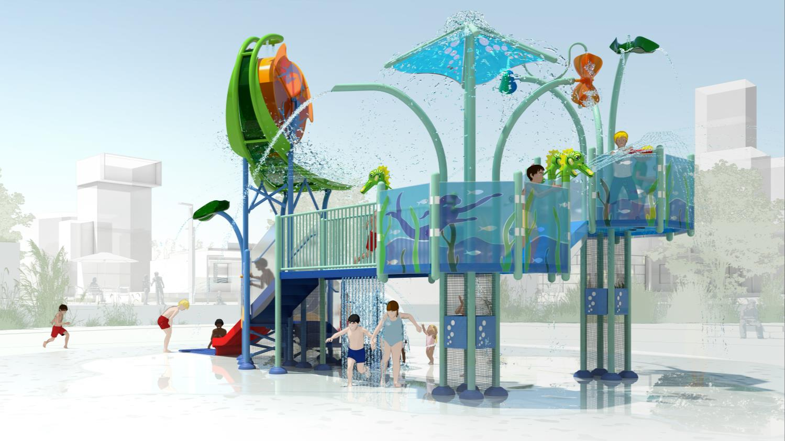
Elevations™ OCEAN

Slide 9
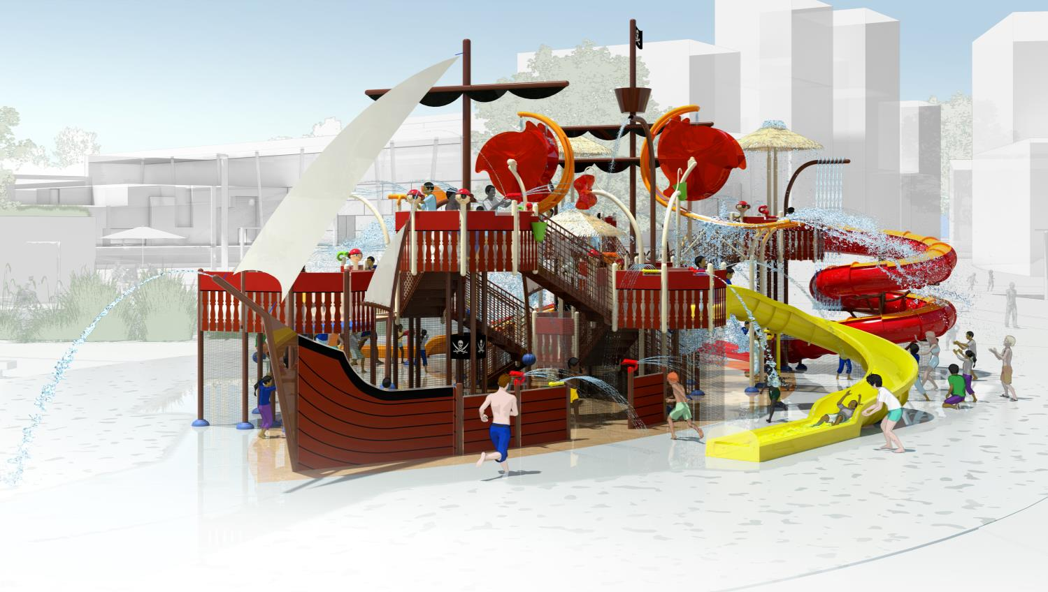
Elevations™ PIRATE

Slide 10
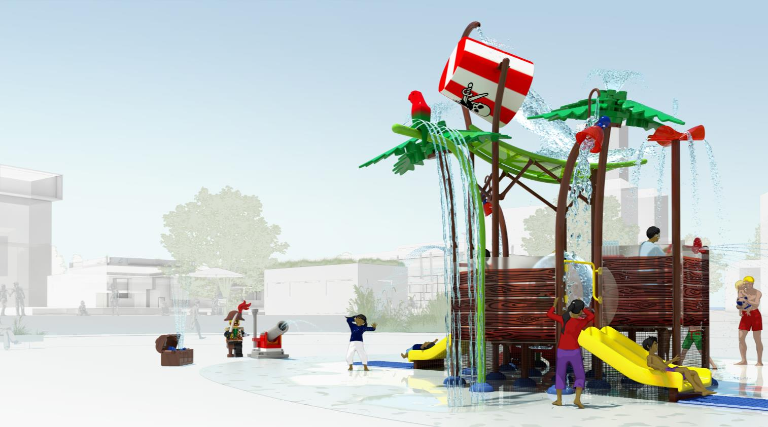
Elevations™ BRANDED THEMES
Notes:
BRANDED THEMES: ELEVATIONS TM CAN BE CREATED WITH COLORS AND SHAPES THAT IDENTIFY WITH YOUR BRAND

